Slide 1
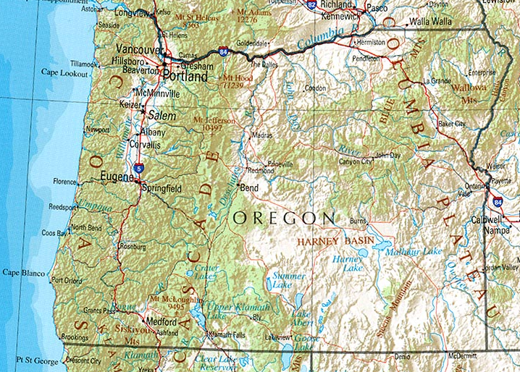
Finding $$$ for
Oregon $tudents
Grant$, $cholar$hip$ and more…
Notes:
Into self
Who’s in High School? College? Parents?

Slide 2

Agenda
Remind-staying in touch with opportunities
Super Important Dates
FAFSA Overview
OSAC Overview

Slide 3
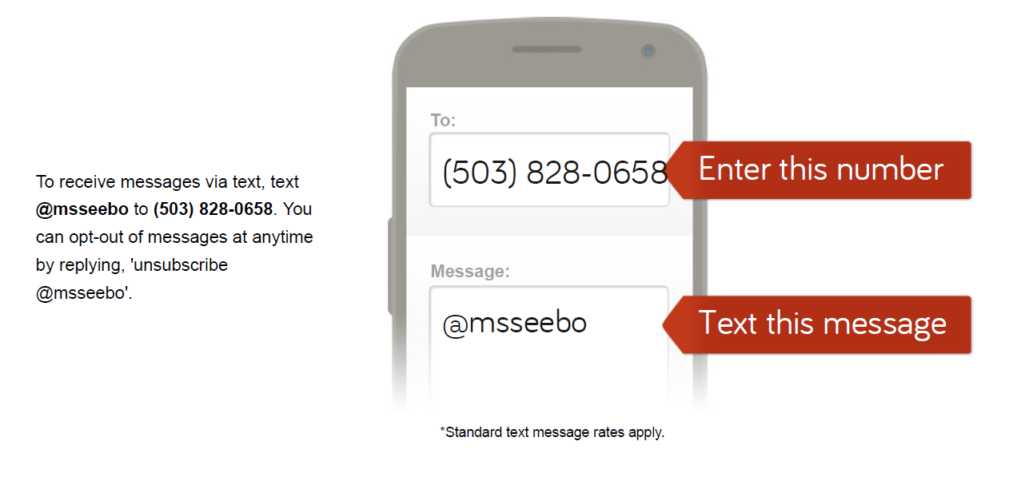
REMIND
By registering for this program you will receive periodic test messages from Ms. Seeborg regarding upcoming events and opportunities as well as scholarships.

Slide 4
Super Important Dates!
December 16th
  After school-OSAC work session
  6pm-Financial Aid Night-Glencoe Library
January 1-FAFSA opens-www.fafsa.gov
January 7-FAFSA help at GHS
February 17-OSAC due
ASAP-Senior Project completion

Slide 5
FAFSA
Filling out the FAFSA video from http://youtu.be/c-23SMf5DyQ
Take note of…
  Website: www.fafsa.gov
  Documents needed to fill out the FAFSA
  What do you need to do before filling out the FAFSA?
    Apply for a PIN: www.pin.ed.gov

Slide 6
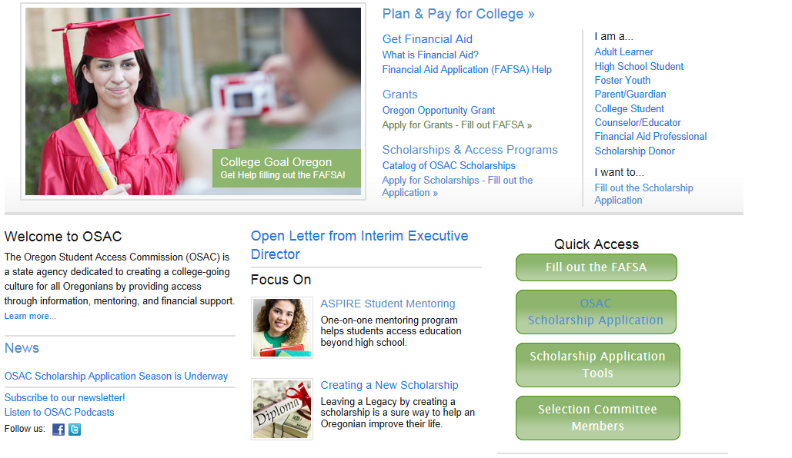
OSAC Scholarship Program
www.getcollegefunds.org
Notes:
Please use the eApp if possible. It helps you submit a complete application. BUT, you must still print it, sign it, attach a transcript, and deliver or mail it to OSAC.
There are also PDF’s online to download of each publication
OSAC can only accept 1 application per year per student. If you submit more than one, OSAC will keep only the one with the latest date.
See the application for detailed instructions on how to submit changes if needed.

Slide 7

OSAC Scholarship Deadlines
February 17
Priority Deadline for Early Bird Scholarship
  Automatically entered into a drawing for $500 by lottery
March 1
Absolute Deadline
www.getcollegefunds.org
Your application must be complete to compete!

Slide 8
Components of the OSAC
Create application login
Identifying Information
  High school info, contact info, background info, residency
Identify Scholarships
Activities Chart
Personal Statement
Transcript

Slide 9
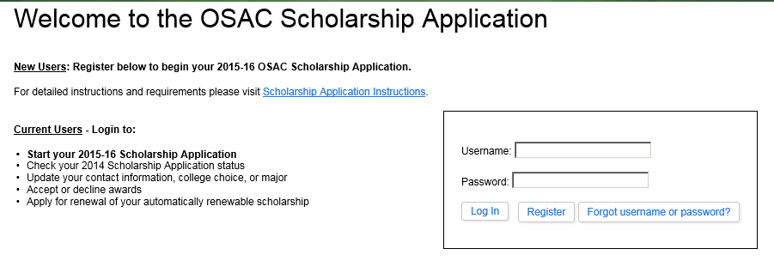
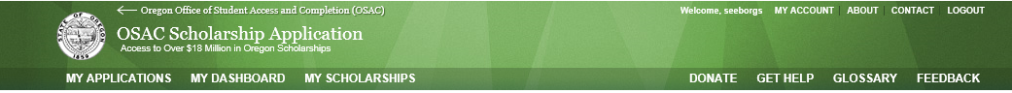
Start Your Application www.getcollegefunds.org
Helpful if you know your social security number
Notes:
This is the home page for eApp.
Test that your printer is compatible with the eApp
You can start an eApp
Access your existing eApp
Coming soon.. Retrieve your application from the prior year. This will make it easier to apply each year you are in school.

Slide 10
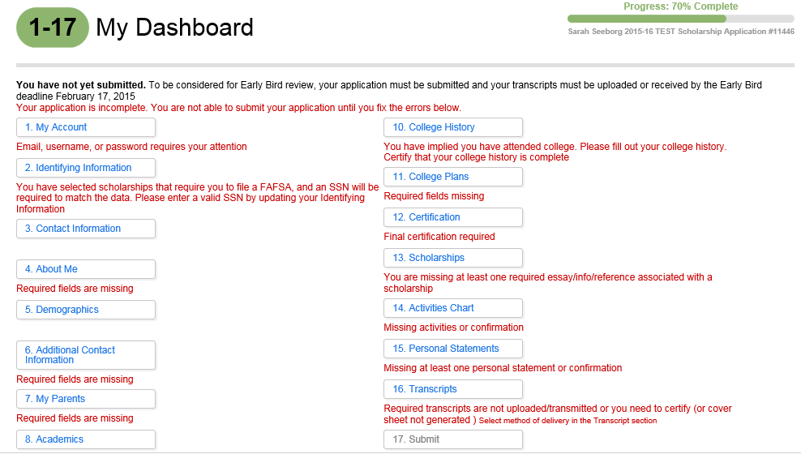
If you’ve taken classes for PCC credit include that info in College History. See Ms. Seeborg for a list of PCC classes and credits

Slide 11
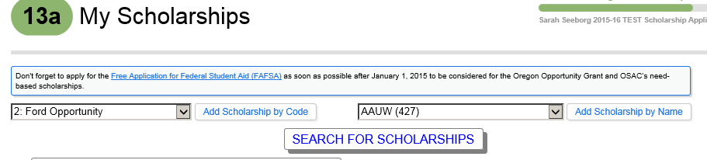

Slide 12
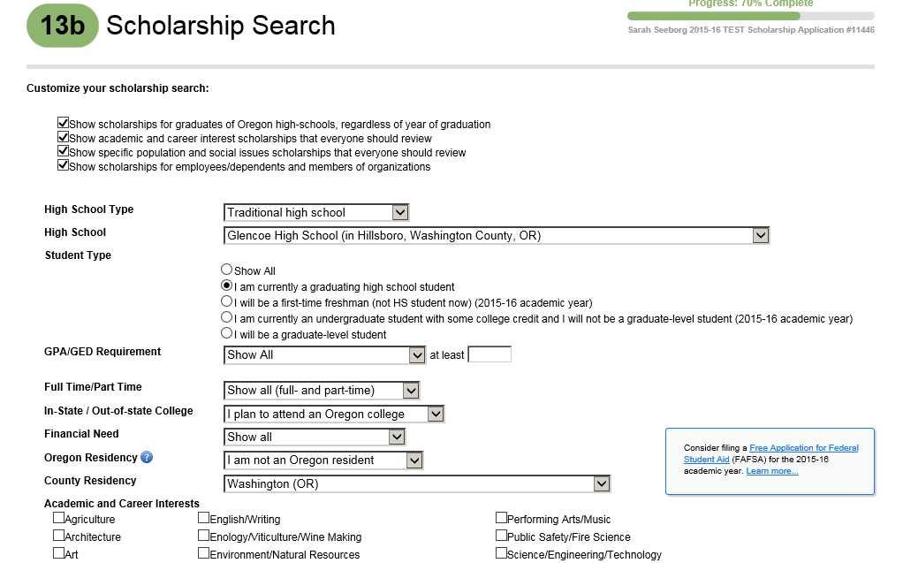
If you know your parents and grandparents do not belong to any organizations, you may want to unclick this box

Slide 13
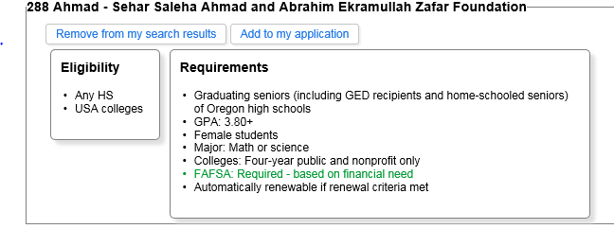
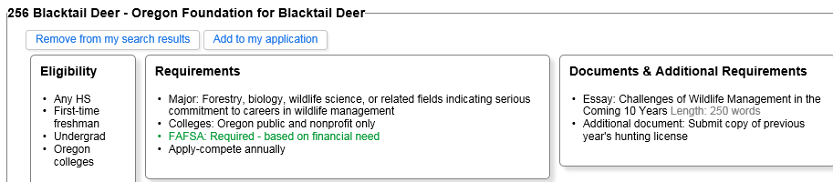
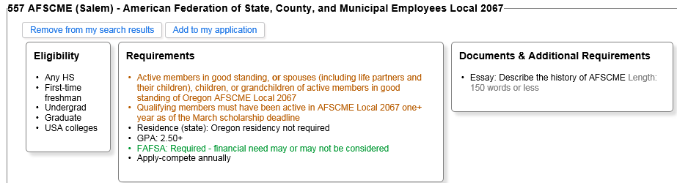
Examples of scholarships.
Green means FAFSA is required. Orange means they are specific to an organization. Some require additional documents such as an essay.

Slide 14
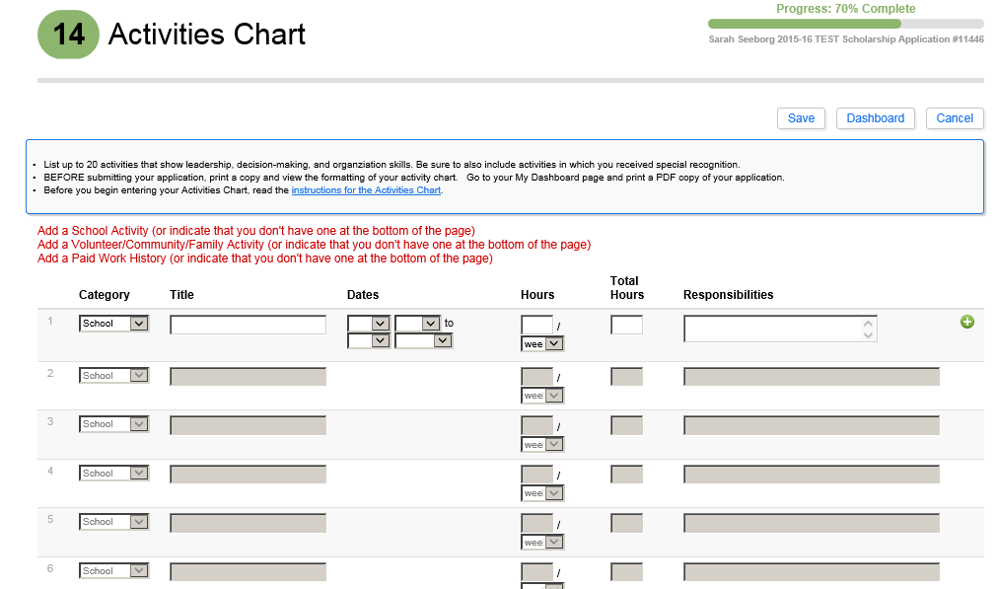
Templates online at www.GetCollegeFunds/eapp.html
Notes:
The Activities Chart must be on one page maximum. The online version is designed to print on one page with a maximum of 20 activities.
________________________________________________
To add an activity to your list of activities:
Select the activity category, one of the following:
A. School/Family/Community Activities
B. Volunteer Service-volunteering can be work you’ve done for your family, translating for example
C. Work for Pay
Add a short title for the activity
Dates From: month and year of when you first began that activity
Dates To: either check 'To present' if you are currently doing this activity, or enter month and year when last did that activity
Time spent: hours per unit (select the unit from the dropdown list), and total hours-do not say “varies.” Give your best estimate
A short description of the responsibilities and/or accomplishments for that activity (up to 115 characters)
Click on the 'Add this activity' button and the activity will be added to your list (displayed below the buttons), or click on the 'Cancel' button and the activity is not added and the form is cleared
The activities in the list are automatically ordered by
The activity category (A, then B, then C), then
The most recent activity (latest "To date"), then
The longest duration activity, then
Activity title

Slide 15
OSAC Short Essay Questions
Explain your career aspirations and your educational plan to meet these goals. Be specific.
Explain how you have helped your family or made your community a better place to live. Please provide specific examples.
Describe a personal accomplishment and the strengths and skills you used to achieve it.
Describe a significant change or experience that has occurred in your life. How did you respond and what did you learn about yourself?
Notes:
You can actually read them on this page. It’s a good idea to write the essays in a word document and paste them into the application
Methods for Creating Your Four Required Short Essay Answers:
Essay forms in the eApp (online Application):
The essays will print along with your two-page application and Activities Chart in PDF
They are formatted for you (it will ignore underlines, bold, and italics) and will print two essays per page, as required.
This method has a limitation on the number of characters you type so check the printed essays
You can either type in the text directly or cut and paste it in. If you type it in directly, be sure to save often. If your computer sits idle too long, it will “time out” and you may lose any unsaved information.
Essay templates:
Available in PDF and as Microsoft Word documents The forms are already formatted for you and will print two essays per page, as required.
The Word documents can be saved on your own computer, and allows you to cut and paste the text into the document or type it in directly.
The PDF version is a fillable document that requires Adobe Acrobat Reader on your computer; this version cannot be saved on your computer.
Create your own from scratch
You may create and print your essays using whatever method you are most comfortable with. The four required Short Essay Answers should be printed two to a page If you are not using a word processing program, type it or print neatly in dark ink.
Use white paper; double space your lines; if using word processing software, use 10-12 pt. type size and an easily readable type style (e.g., Times New Roman).
Put your name, last four digits of your SSN, and your eApp number in the top right corner of each page.

Slide 16
Transcripts
Follow the directions!
OSAC application requires
  Send in transcript with 1st semester grades
  Available beginning of February
  A missing or incomplete transcript is the No. 1 reason
  for a rejected OSAC application
Notes:
What happens if you send your 6th semester, not your 7th….it does NOT get forwarded to selection committees for review.
For OSAC, the transcript should be unofficial

Slide 17
Tips to remember!
Follow the instructions and be on time
Spell check & proofread
Keep a copy of everything you submit
Attach all required documents
Order the correct transcript
Reflect your best work

